Slide 1
Post Modernism Revisited
David Williams

Slide 2
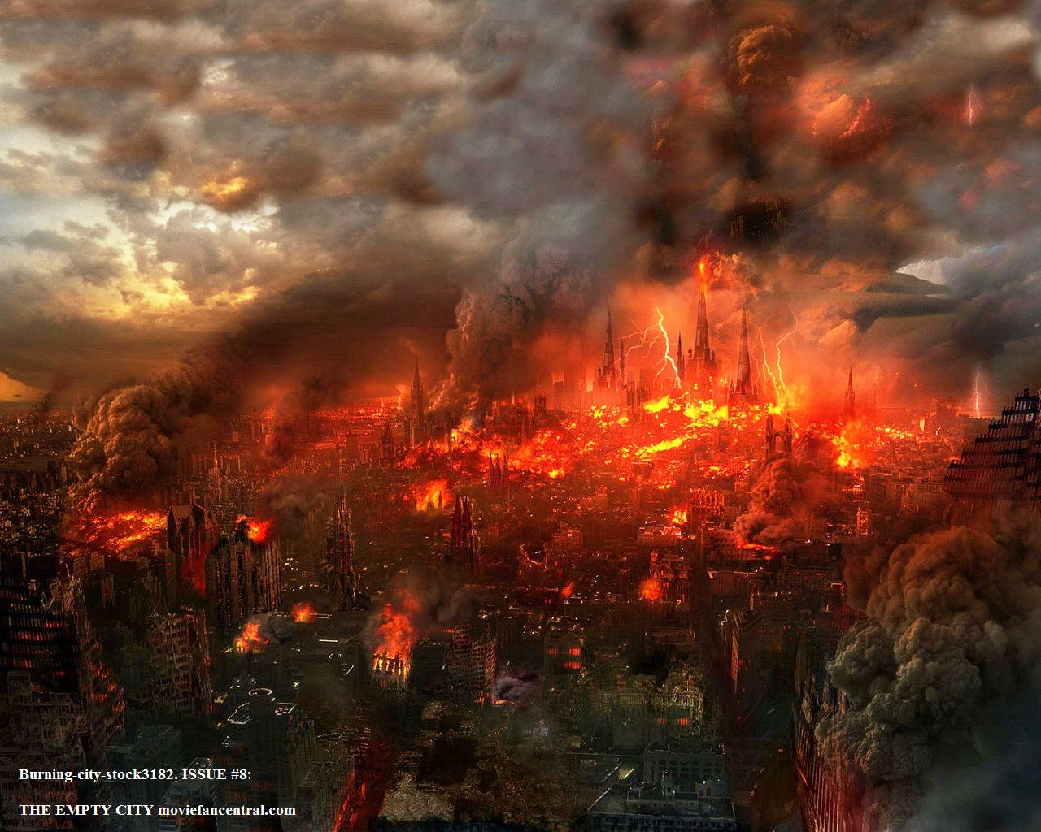
Strange World
http://www.biblebookofrevelation.com/Limages/Burning_City.jpg

Slide 3
Post Modernism Revisited
https://s3.amazonaws.com/borrowed-and-blue-staging/photos-images/506897/hero-open-uri20140930-2-61jcqn.jpg?1412101965

Slide 4
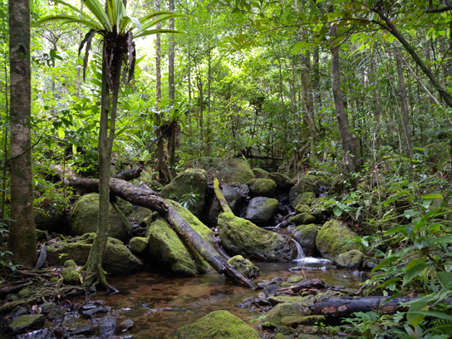
Ecosphere Forces
http://philschatz.com/biology-concepts-book/resources/Figure_21_01_01.jpg

Slide 5
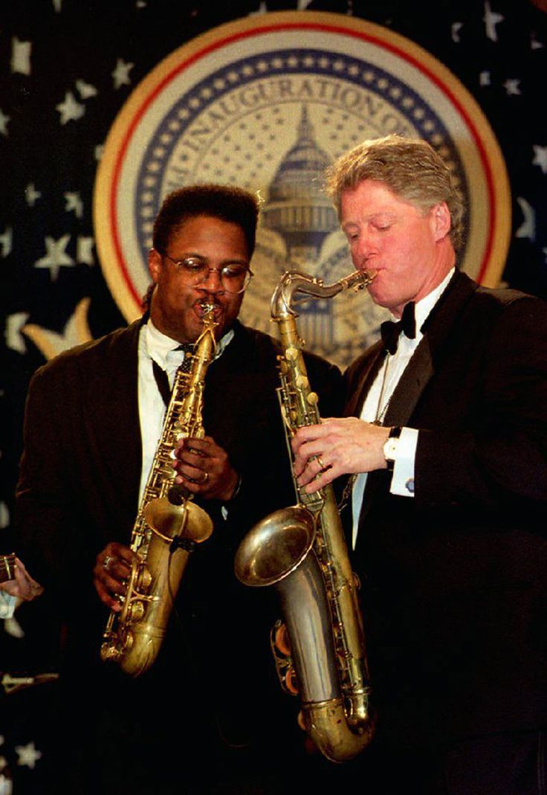
Legislative Disastotunities
https://s-media-cache-ak0.pinimg.com/736x/83/b9/2a/83b92aa28a56cb3f3d27b8ead09b5fb2.jpg

Slide 6
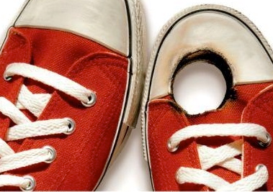
Self-Inflicted Gunshot Wounds
http://extremebballskills.com/wp-content/uploads/2014/03/shoot-in-foot.jpg

Slide 7
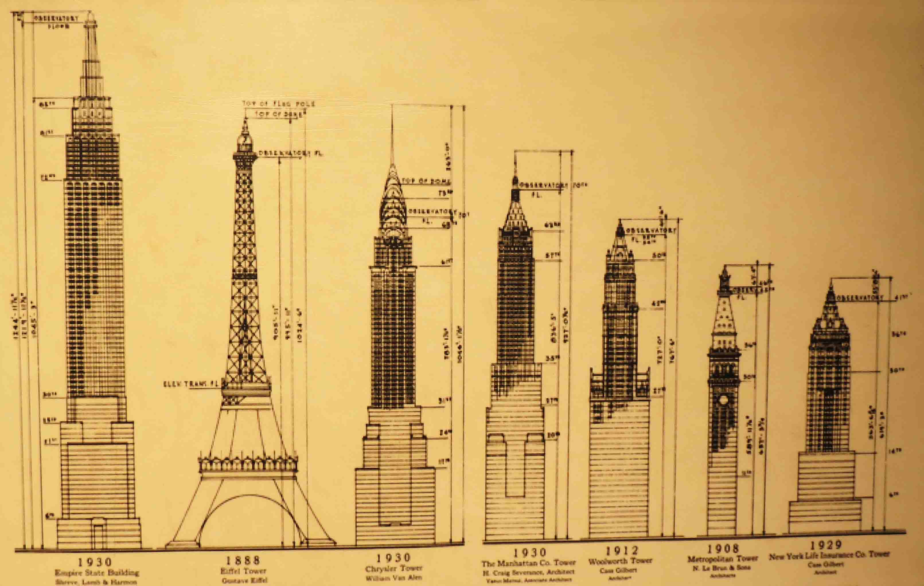
Structuring a Solution
https://lostfoundremembered.files.wordpress.com/2012/08/esb4.jpg

Slide 8
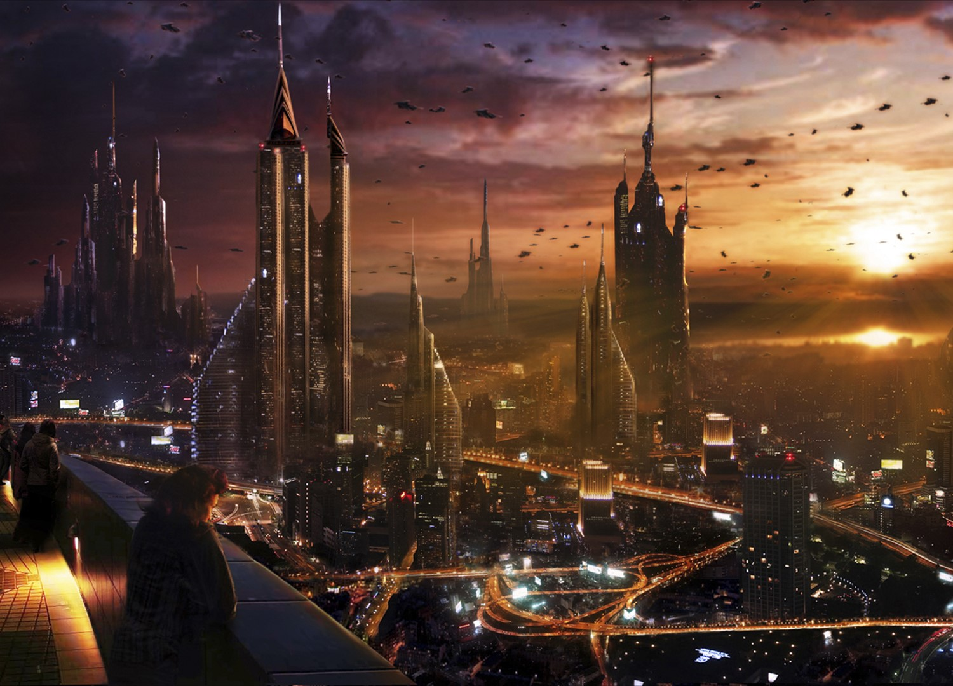
Imagining the Next

Slide 9
I Heard The News Today - Oh Boy...
http://www.biblebookofrevelation.com/Limages/Burning_City.jpg

