Slide 2
MTAC Update…
… January 14 – 16, 2014
Wanda Senne
NAAD Meeting, February 28, 2014

Slide 3
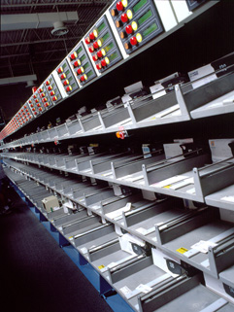
Agenda
Service Performance
MTE
POSt Plan
Labeling Lists
5-Digit Schemes
Load Leveling
Full-Service Intelligent Mail Numbers
UAA Study
PAF Policy
PARS for Flats
FAST Appointments
FCM Single Piece Rates
Patent Troll Legislation

Slide 4
Service Performance PQ I/FY14 October – December 2013
First-Class Mail 95.89 for overnight
95.22 for two-day (target: 96.80)
93.26 for three- to five-day committed mail (targets 96.50, and 95.25, respectively)
Standard Mail letters
89.95 for SCF entry (target of 91.00)
90.83 for NDC entry (target of 91.00)
SCF- and NDC-entered flats
74.27 and 84.17 (91.00 target)
Periodicals scored 83.87
Target of 91.00

Slide 5
Mail Transport Equipment – MTE
No cancelled orders during fall 2013 mailing season
Largest available MTE inventory in five years exceeded demand
Access MTEOR system for local mailers will be phased in by area: February thru September
Phase 1 of network rationalization (affecting 178 facilities) Complete February 1
Implementation of Phase 2, and the concurrent second round of service standard changes, has been postponed.
No reschedule date was announced.

Slide 6
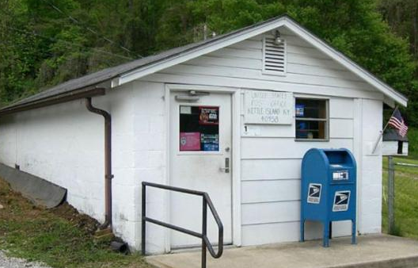
POSt Plan
Implementation of the POSt Plan (reducing retail hours at low-activity post offices) was completed at 7,995 sites during FY 2013
Will be completed at the remaining 5,186 sites during FY 2014

Slide 7
Labeling List Release Cycle
Starting with the June 1, 2014 labeling list publication, USPS will provide a 30-day grace period for upcoming labeling list changes effective July 1, 2014 and monthly publication of labeling lists will begin in June
MERLIN machines have three sets of labeling lists.

Slide 8
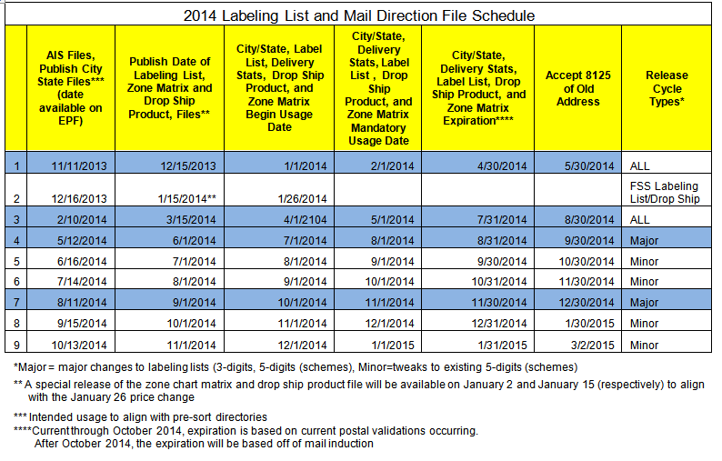
Labeling List Release Cycle

Slide 9
5-Digit Scheme Changes
USPS expanded its L006 labeling list
Less separations required at the container level
Fuller trays
Bigger bundles
Larger pallets
Better utilization of transportation
Monthly publication of labeling lists allows the USPS flexibility to update the lists based on changes in their environment

Slide 10
Load Leveling
December 27, 2013 USPS filed a request for an advisory opinion at the Postal Regulatory Commission (PRC)
Published a proposed rule in the Federal Register. Comments to the Federal Register notice due by February 13
The proposed load leveling concept is an attempt to address “service variability, operational inefficiencies, and increased cost” resulting from the volume of mail deposited late in the week for Monday delivery.
(According to the USPS, on average, about 42% of DSCF Standard Mail volume is drop shipped by mailers on Friday, and committed for delivery on Monday.
During FY 2013, 54.4% of the occasions on which carriers completed their routes after 5pm were on Mondays.

Slide 11
Load Leveling
DSCF Dropped before 4:00 pm on: | Delivery Days Meeting Service Standard CURRENT | Delivery Days Meeting Service Standard PROPOSED
Thursday | Friday, Saturday, Monday | Friday, Saturday, Monday
Friday | Saturday, Monday | Saturday, Monday, Tuesday
Saturday | Monday, Tuesday | Monday, Tuesday, Wednesday
Sunday | Monday, Tuesday, Wednesday | Monday, Tuesday, Wednesday

Slide 12
Full-Service Intelligent Mail #s
In PQ I/FY 14 Full-Service IMb:
71% of commercial First-Class Mail
59% of Standard Mail letters and 51% of Standard Mail flats
Inclusion in FS/IMb Service Measurement:
42% of Presort First-Class Mail letters
31% of Standard Mail letters
22% of Standard Mail flats
FS/IMb mail but ineligible for inclusion in service measurement variety of reasons: missing scans (primarily start-the-clock or piece scans), discrepancies in eDoc, or errors in mail preparation. Also excluded from measurement were eligible non-FS/IMb and FS/IMb ineligible pieces.
29% of Presort First-Class Mail letters
28% of Standard Mail letters
29% of Standard Mail flats

Slide 13
UAA Study
A new page about the ongoing UAA mail study has been added to the RIBBS site.
In FY 13, there were nearly 6.8 billion UAA pieces, costing the USPS more than $1.3 billion to handle.
https://ribbs.usps.gov/index.cfm?page=uaamail

Slide 14
PAF Policy
An updated NCOALink PAF policy has been issued, effective last October 1, 2013.
Customers need to update existing PAFs if any information has changed.
Existing Policy:
Prior to customers’ anniversary dates, Licensees would notify their customers that their current PAFs are nearing expiration and they will need to complete new PAFs, even if contact or address information has not changed. Future NCOALink processing could not be performed if the existing PAFs expired before new ones were received. Copies of the PAFS were kept on file by licensees for a period of six years.
Alternative Policy:
Prior to customers’ anniversary dates, Licensees will send PAF renewal notifications – via email, fax, U.S. Mail, or website click-through acknowledgement – requesting customers to review their existing PAF and provide any changes to their contact of address information.

Slide 15
PARS for Flats – Spring 2014
The USPS is conducting First Article testing of its Postal Automated Redirection System (PARS) for flats beginning in Spring 2014.
USPS conducted critical design review of the FPARS system last October, and plans to deploy FPARS to 18 existing CFS sites in spring 2014, with 22 AFSM 100 machines modified for PARS processing.
FPARS differs from the PARS process used on letter sorting equipment.
PARS for letters intercepts and redirects the mailpiece at the first scan on automated equipment equipped with PARS.
For flats, the piece will be processed on automated equipment, sent to the carrier for delivery at the destination delivery unit, then sent to CFS, then on to the FPARS automated equipment at the destination plant to be labeled and redirected to the right address.

Slide 16
FAST Appointments
Expanding appointment availability in FAST at postal plants using standard methodology to apply appointment availability at plants to allow more appointments that currently are available
Currently, there are no standards and facilities can set the appointment availability themselves
Since September there have been problems making appointments at some plants because the system says the plant is at capacity.
The USPS is looking at data, equipment availability, planned volumes and other indicators to determine the appointment methodology.
Testing the methodology in South Jersey and plans to roll out the project to 76 plants between January and April, then move to implement nationwide.
The USPS noted there is still a significant problem with “no show” appointments(approx 30% of FAST appointments)

Slide 17
FCM Single Piece Rates
First-Class Mail (FCM) users had asked the USPS to remove the 200-piece minimum for Single Piece FCM to be submitted in eDoc to allow for permit imprint on FCM for less than 200 pieces in a mailing.
USPS said it will do so effective January 26, 2014, but no official change in the Domestic Mail Manual (DMM) requirements has yet been seen
Guide to Intelligent Mail for Letters and Flats will be updated

Slide 18
Patent Troll Legislation
The USPS reported that it plans to take some kind of action in the ongoing patent infringement lawsuits concerning the Intelligent Mail barcode (IMb)/QR Codes.
USPS General Counsel Tom Marshall reported that the USPS is well aware of the patent activity that potentially implicates things like IMb Full-Service, and said the USPS will be working to protect its interests and help its customers. Marshall said the USPS is finalizing its strategy on how to more directly protect its interests and can't disclose the details yet.
He said the USPS also is working through its government relations group to determine the best strategies to support the Innovation Act legislation being considered by Congress.

Slide 19
Thank you for your time…
Questions & Answers

